Slide 1

Brand Strategy
STRATEGY CORE
MESSAGING + BEHAVIOUR
THE OFFER
01 AUDIENCE
Startup founders, pre-launch teams, SME owners and corporate teams in Singapore who need a go-to-market brand, not a theory course
01 MESSAGE
One day, three connected assets: a 1-page brand guide, an editable PowerPoint and a 1-page website
BUILD AND DEPLOY YOUR BRAND IN A SINGLE DAY.
02 POSITIONING
Practical AI branding masterclasses that take a business from strategy through creation to market activation in one focused day
02 MESSAGE
Led by TÜV SÜD-certified brand consultants, with certification recognised by Enterprise Singapore
THREE ASSETS. BUILT TO WORK TOGETHER.
01
02
03
1-page brand guide
Editable PowerPoint
1-page website
03 BRAND PROMISE
Build and deploy your brand in a single day — three connected deliverables, ready to go to market
03 MESSAGE
25+ years of brand practice, supercharged with generative AI — the judgement stays human
PROOF
25+
3
1
Years of practice
Connected stages
Focused day
04 PERSONALITY
Practical not theoretical; fast not rushed; certified not self-appointed; direct not salesy; hands-on not lectured
04 VISUAL DIRECTION
Near-black ground, Electric Blue accent, oversized uppercase Urbanist, numbered indices, double-chevron motion motif
15
3
6
Participants max
Assets delivered
Course stages
05 VOICE
Compressed imperatives in uppercase — “Build it fast. Launch with purpose.”
05 GUARDRAILS
Never promise a finished brand — assets are built to refine; never sell AI as a substitute for judgement; never exceed 15 participants
CERTIFIED
DELIVERY
PARTICIPANT
“Our sales increased by 247%.”
TÜV SÜD-certified consultants; recognised by Enterprise Singapore
Thanikodi Iswaran · DairyFolks
PREPARE · CLARIFY · CREATE · BUILD · ACTIVATE · REVIEW
brandaccelerator.ai

Slide 2
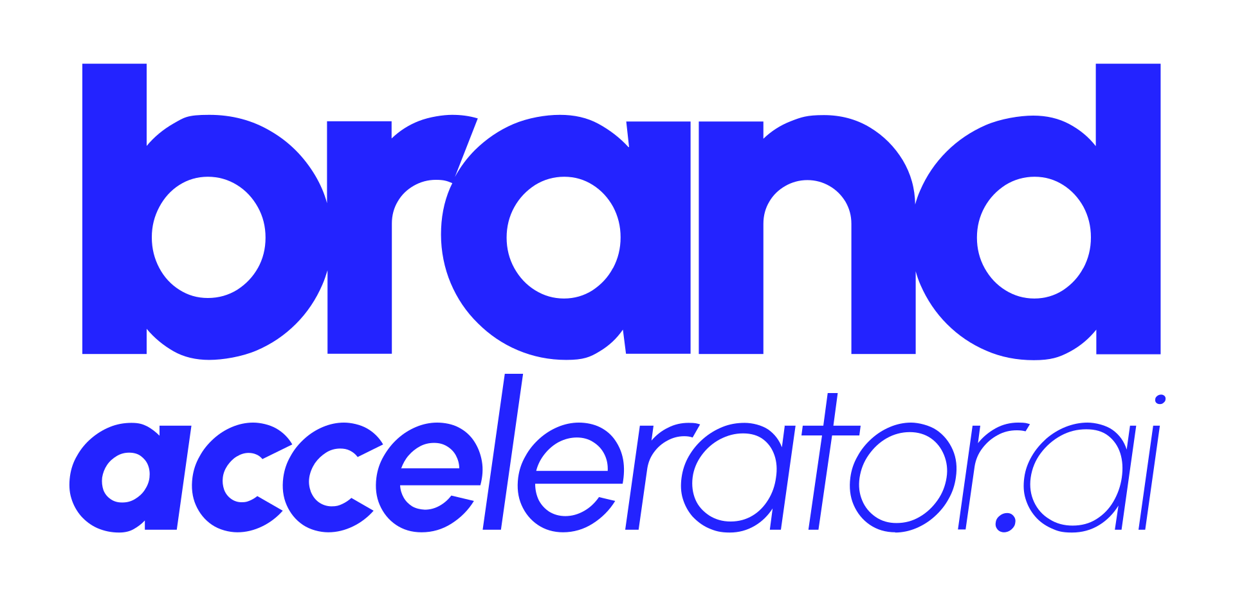




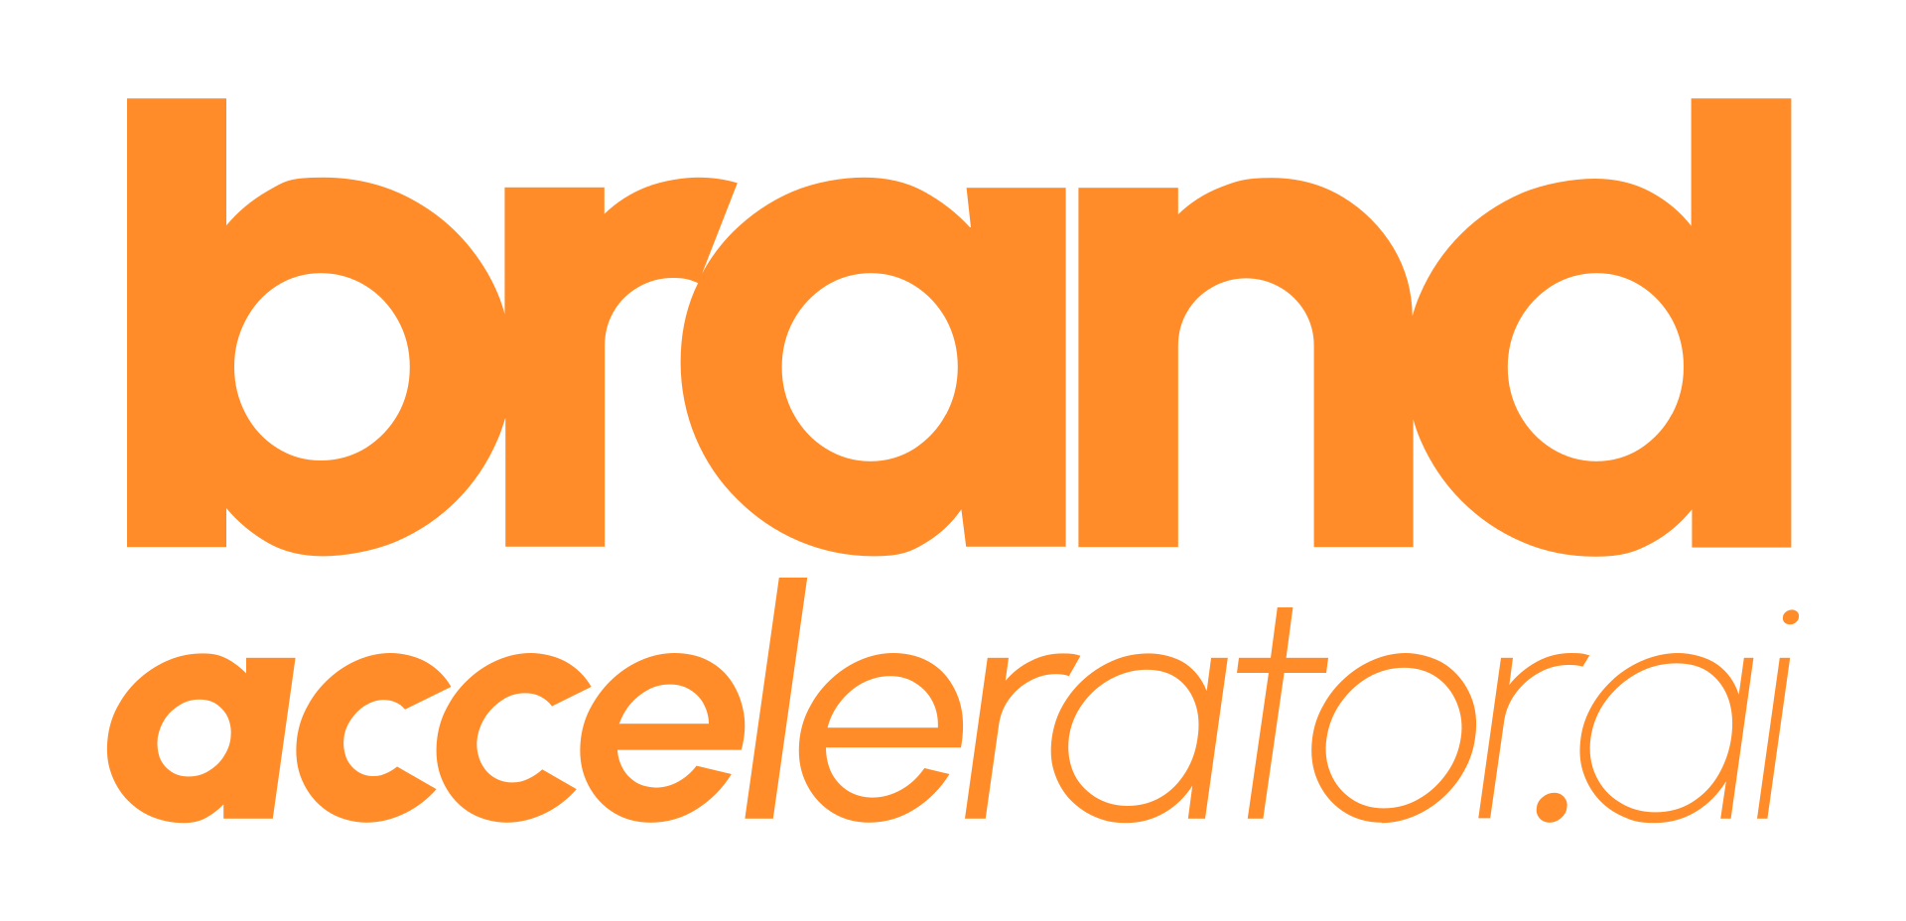

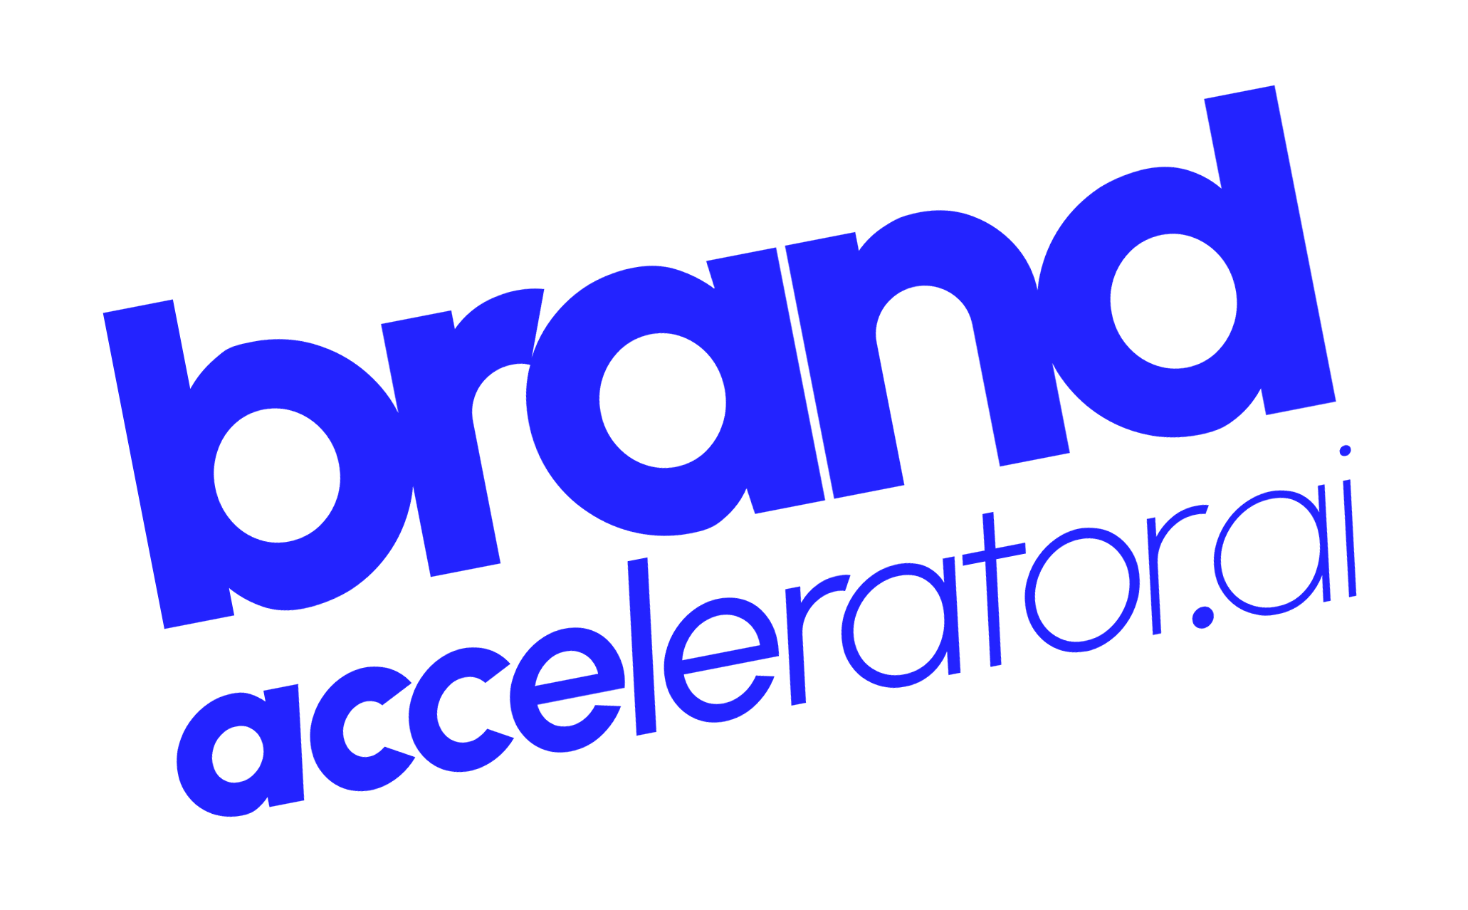
Brand Guide
PRIMARY LOGO
REVERSED LOGO
COLOUR SYSTEM
INK
ELECTRIC BLUE
DEEP BLUE
BLUE LIGHT
PAPER
Electric Blue lockup on Ink or Paper. The default mark. Never re-space or re-weight the letterforms.
Solid white on Electric Blue or over imagery. The only permitted single-colour version.
HEX #050505
RGB 5 5 5
CMYK 0 0 0 98
HEX #2323FF
RGB 35 35 255
CMYK 86 86 0 0
HEX #1111A8
RGB 17 17 168
CMYK 90 90 0 34
HEX #8C8CFF
RGB 140 140 255
CMYK 45 45 0 0
HEX #F4F5F7
RGB 244 245 247
CMYK 1 1 0 3
SYMBOL
CLEAR SPACE + MINIMUM SIZE
Electric Blue on Ink measures 2.7:1 — reserve it for display type, rules and graphic elements, never body copy.
For small text on dark use Blue Light (7.1:1). CMYK derived from hex; no Pantone is published.
Clear space on all sides equals the cap-height of BRAND. Minimum width 28 mm in print, 80 px on screen. Below that use the symbol alone.
TYPOGRAPHY
Double chevron — app icon, favicon, bullet
One family, all roles
LOGO ON BACKGROUNDS
Urbanist
Light 300
Regular 400
Bold 700
ExtraBold 800 — display
Black 900 — hero only
Uppercase, tight tracking
Fallback: Arial. Variable weights 400–900 are all in use — set the axis, not a substitute face.
On Ink — primary
On Electric Blue
On Paper — light mode
Signature move: weight decays left to right through “accelerator.ai” — acceleration written into the letterforms. Never rebuild it.
MISUSE — NEVER
recolour · distort · rotate
DESIGN ELEMENTS
01
JOIN ›
BUILD IT FAST.
LAUNCH WITH PURPOSE.
Play > Accelerate symbol
Numbered index
Accelerate button
No other colour
No distortion
No rotation
Slogan
STRATEGY · CREATION · ACTIVATION
brandaccelerator.ai

