Slide 1
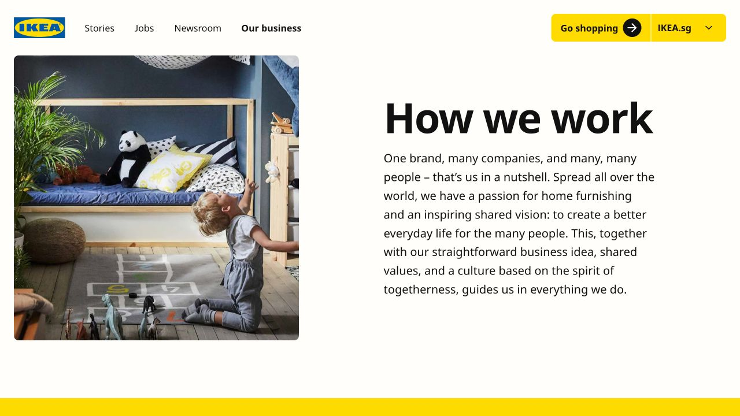
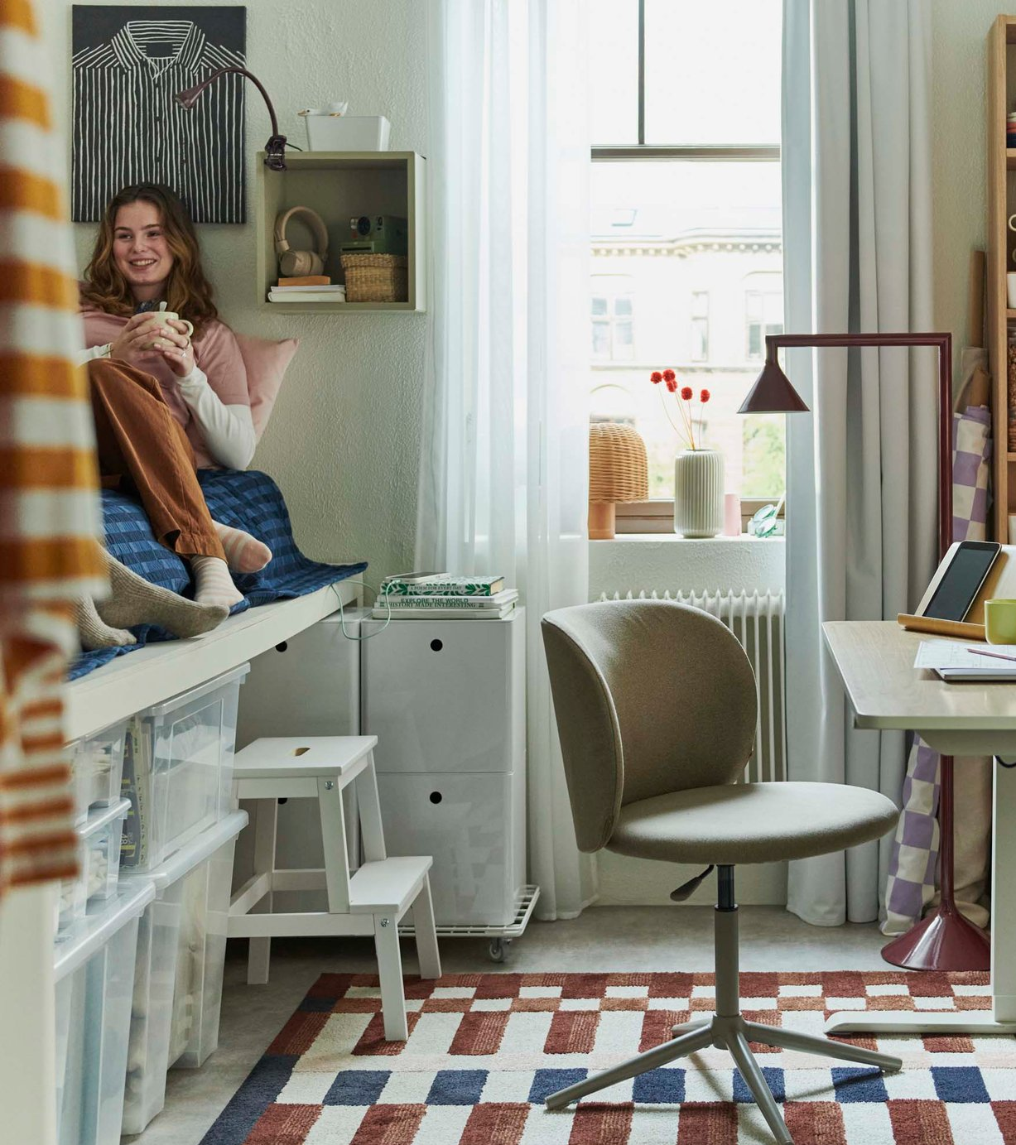
IKEA Brand Strategy
DESIGNED FOR THE MANY
STRATEGY CORE
MESSAGING + BEHAVIOUR
AUDIENCE
The many people—ordinary households seeking to improve everyday life at home
MESSAGE 1
Good design should be available to many people
MESSAGE 2
Products must work well in real everyday life
POSITIONING
Well-designed and functional home furnishings made accessible through low prices
MESSAGE 3
Affordability should not require abandoning form, quality or sustainability
BRAND PROMISE
Better everyday living through thoughtful, functional and affordable home furnishing
SLOGAN
EXPRESSION
VISUAL DIRECTION
Recognisable blue and yellow, straightforward product presentation and relatable home situations
“The
Wonderful
Everyday”
PERSONALITY
Practical, optimistic, human and playfully resourceful
VOICE
Simple, friendly, inclusive and non-pretentious
GUARDRAILS
Never prioritise appearance over function; never become elitist; never detach design from affordability or everyday usefulness
PROOF SYSTEM · DEMOCRATIC DESIGN
Form • Function • Quality
Sustainability • Low price
Notes:
[Sources]
- User-provided brand-strategy copy.
- IKEA logo: https://www.ikea.com/global/assets/logos/brand/ikea.svg
- IKEA living-room image: https://www.ikea.com/global/en/media/PH_208374_559f789e42.jpg
- IKEA compact student-room image: https://www.ikea.com/global/en/media/PH_209331_b5f055628f.jpg
- IKEA logo and colours: https://www.ikea.com/ph/en/this-is-ikea/about-us/the-ikea-logo-history-and-design-pub55d85f50/
- Democratic Design: https://www.ikea.com/ph/en/this-is-ikea/about-us/democratic-design-how-ikea-designs-for-everyone-pub5991eac0/
- The Wonderful Everyday: https://www.ikea.com/gb/en/newsroom/corporate-news/ikea-invites-people-to-show-off-your-savvy-pub64ca3880/

Slide 2

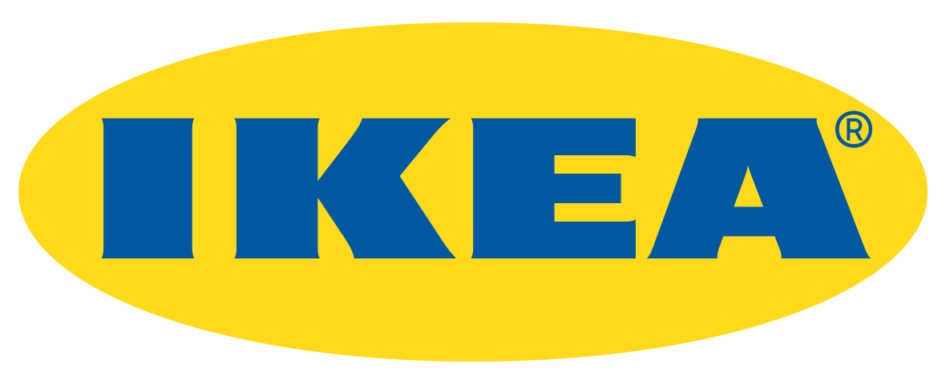

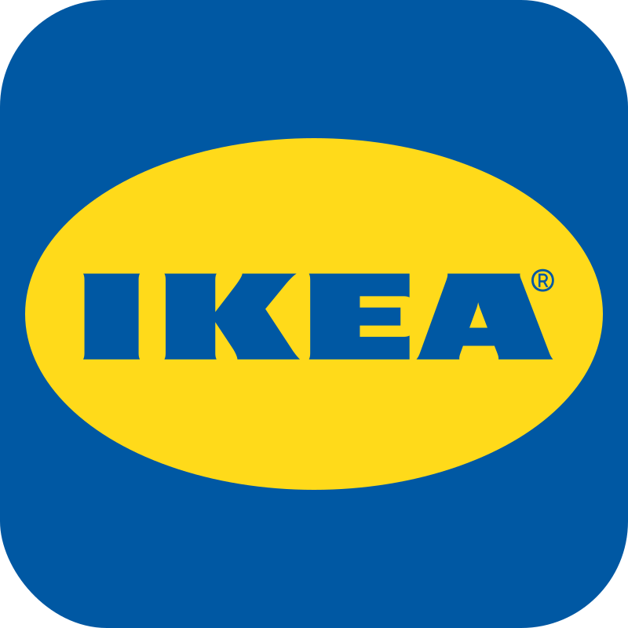

IKEA Brand Guide
THE WONDERFUL EVERYDAY
PRIMARY LOGO
SECONDARY LOGO
COLOUR PALETTE
IKEA BLUE
IKEA YELLOW
INK BLACK
MID GREY
LIGHT GREY
HEX: #0058a3
RGB: 0 88 163
CMYK: 100 46 0 36
PMS: 300 C
HEX: #ffda1a
RGB: 255 218 26
CMYK: 0 14 90 0
PMS: 116 C
HEX: #111111
RGB: 17 17 17
CMYK: 0 0 0 93
PMS: Black 6 C
HEX: #929292
RGB: 146 146 146
CMYK: 0 0 0 43
PMS: Cool Gray 7
HEX: #f5f5f5
RGB: 245 245 245
CMYK: 0 0 0 4
PMS: 663 C
Oval and wordmark only — for IKEA Blue backgrounds and busy photography.
Full-colour lockup — the default mark for every application. Never redraw, recolour or re-typeset it.
SUBMARK
FAVICON
Blue and yellow carry the identity — greys are supporting neutrals only, never brand colours.
CLEAR SPACE + MINIMUM SIZE
TYPOGRAPHY
Keep clear space on all sides equal to half the logo height. Minimum width: 20 mm in print, 60 px on screen.
Use for H1, headlines, titles and price
Use for H2, H3, sub-heads and body copy
Noto IKEA Latin
Noto Sans
LOGO ON BACKGROUND COLOURS
Light
Regular
Bold
Light Italic
Regular Italic
Bold Italic
Light
Regular
Bold
Light Italic
Regular Italic
Bold Italic
Legacy faces are retired: Verdana (pre-2019) and Futura (pre-2010). Use Noto Sans CJK for Chinese, Japanese and Korean markets.
On IKEA Yellow — primary
On white — primary
On IKEA Blue — secondary
DESIGN ELEMENTS
“
MISUSE — NEVER
recolour · distort · rotate · add effects
To create a better everyday life for the many people.
No recolouring
No distortion
No rotation
Oval device · circle clusters · yellow rules
— IKEA Vision, Ingvar Kamprad
DEMOCRATIC DESIGN · Form • Function • Quality • Sustainability • Low price
IKEA Brand Guide
Notes:
IKEA Mini Brand Guide — one-page reference covering logo suite, background usage, misuse, colour palette, typography and design elements. Layout system matches the IKEA Brand Strategy one-pager: blue masthead with yellow rule, two-panel body, blue footer.

