Slide 1

Brand Strategy
FOREVER ADVANCING ARCHITECTURE
STRATEGY CORE
MESSAGING + BEHAVIOUR
THE BRAND TRANSITION
01 AUDIENCE
Cultural institutions, civic and transport authorities, developers and city-makers commissioning landmark projects — and the international talent the practice recruits
01 MESSAGE
A collective, not a signature: 500 people from 55 nations, 5 offices, wholly employee-owned
From a founder’s name to a collective one. ZHA Architects Limited began trading as ZHA in 2026; the Zaha Hadid Foundation licence ended in 2025 and those marks are no longer used.
02 MESSAGE
Research is the method, not the marketing — Low Carbon Strategy Handbook, AI-assisted climate modelling
02 POSITIONING
A global architecture and design studio working at all scales, all sectors, all budgets — now under a collective identity rather than a founder’s name
PROOF IN NUMBERS
500
5
36
03 MESSAGE
Proven at every scale, from a chair to a masterplan — 300+ accolades over 40 years
People, 55 nations
Global offices
Under construction
03 BRAND PROMISE
Forever Advancing Architecture: research-led design that anticipates challenges and builds what comes next
22
300+
100%
In design development
Accolades
Employee-owned
04 VISUAL DIRECTION
Absolute monochrome, full-bleed photography, negative tracking, uppercase micro-labels and numbered indices
04 PERSONALITY
Research-led not nostalgic; collective not authored; technical not decorative; expansive not niche; forward-facing not archival
EIGHT
DISCIPLINES
SLOGAN
EXPRESSION
05 GUARDRAILS
Never use the former practice name or Foundation marks; never lead with a single author; never let form outrun performance
Architecture
Interiors
Masterplans
Virtual Spaces
Workplace
Products
Exhibitions
Installations
Forever
Advancing
Architecture
05 VOICE
First-person plural, declarative, unadorned — “We imagine, we research, we innovate”
ALL SCALES · ALL SECTORS · ALL BUDGETS · DESIGNING A BETTER WORLD
ZHA Brand Strategy

Slide 2
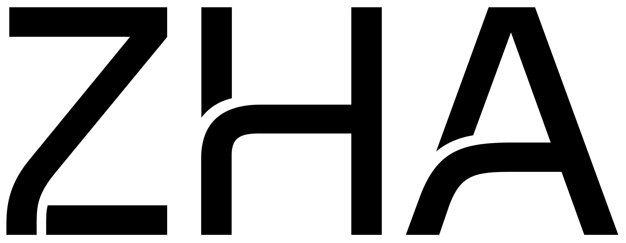
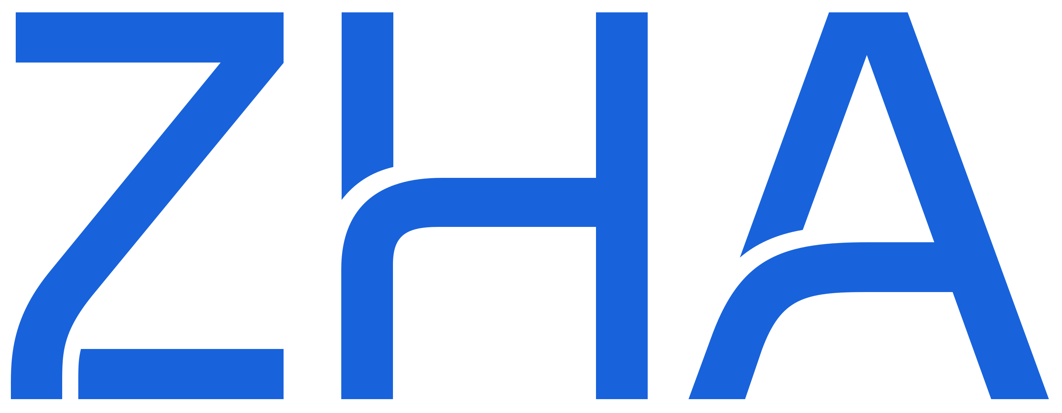
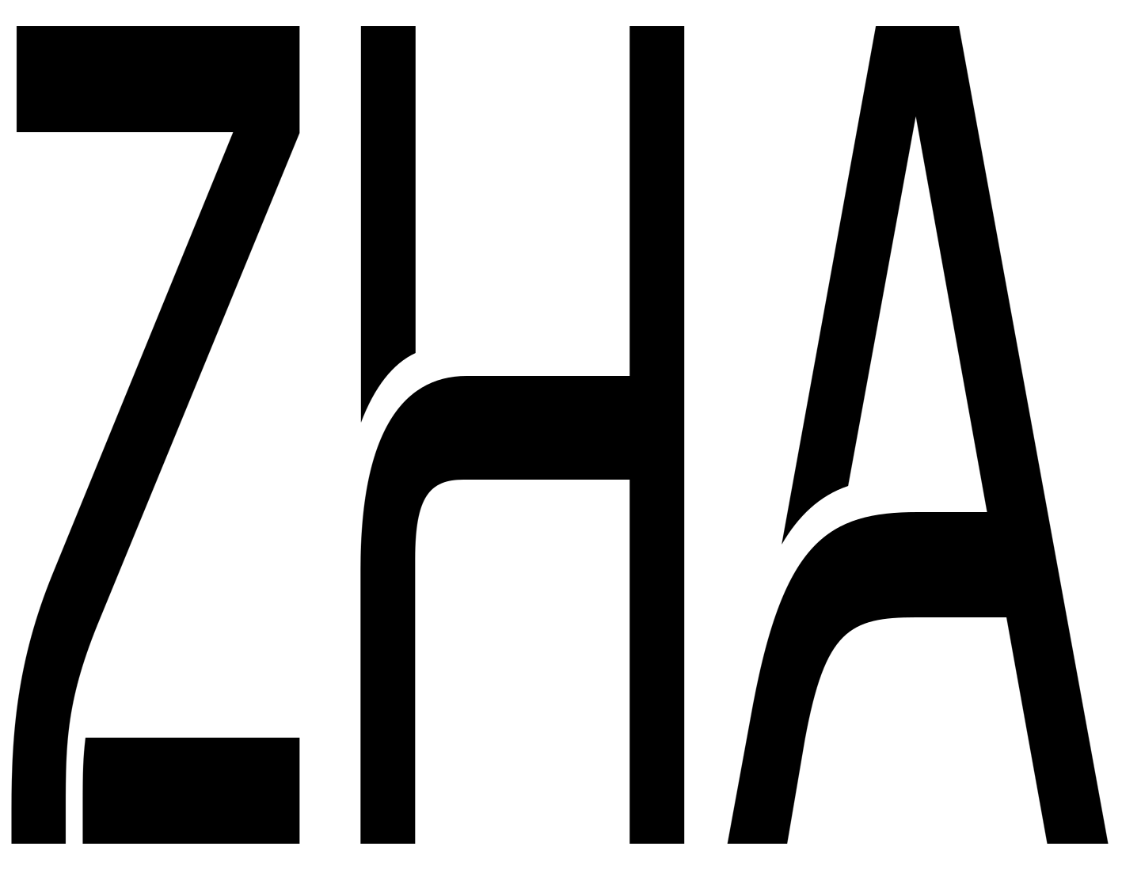
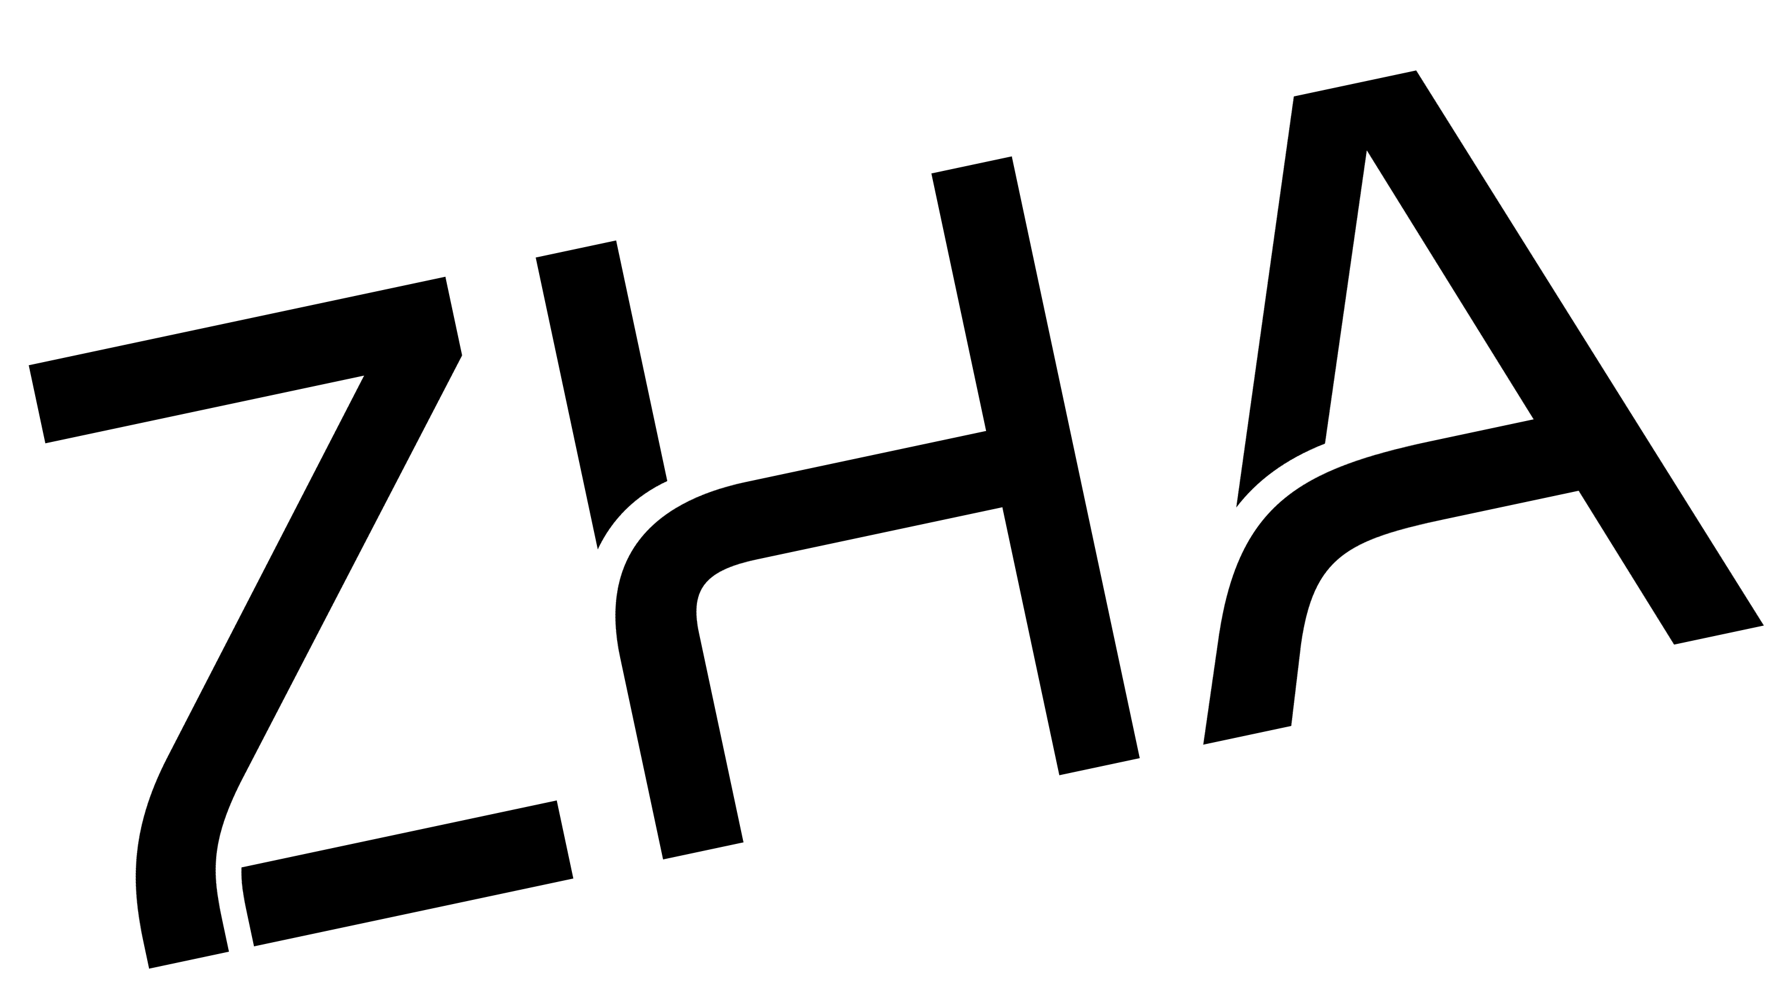
Brand Guide
FOREVER ADVANCING ARCHITECTURE
PRIMARY MARK
REVERSED MARK
COLOUR SYSTEM
Black mark on white or light ground. The default. Never redraw, outline or re-set the letterforms.
White mark on black or over full-bleed photography. No other colourway exists.
ZHA BLACK
ZHA WHITE
SIGNAL GREY
GRAPHITE
HEX: #000000
RGB: 0 0 0
CMYK: 0 0 0 100
HEX: #FFFFFF
RGB: 255 255 255
CMYK: 0 0 0 0
HEX: #D0D0D0
RGB: 208 208 208
CMYK: 0 0 0 18
HEX: #2A2A2A
RGB: 42 42 42
CMYK: 0 0 0 84
CLEAR SPACE + MINIMUM SIZE
APP ICON
FAVICON
Clear space on all sides equals the height of the H. Minimum width: 25 mm in print, 72 px on screen. Below that, no mark.
The system is monochrome by design. No accent colour is specified — colour enters only through photography. CMYK derived from hex; no Pantone is published.
TYPOGRAPHY
MARK ON BACKGROUNDS
One family, all roles
Substitute
Neue Haas Unica W1G
Arial
Regular
Medium
Bold
Display −0.6 to −1.2px
Body −0.35px
Labels −0.28px, UPPER
The practice’s own declared fallback. Use where Unica is not licensed.
On black — primary
On white — primary
On Signal Grey — permitted
Tracking is always negative. Labels and navigation are uppercase; headlines are sentence case.
MISUSE — NEVER
recolour · distort · rotate · outline
DESIGN ELEMENTS
01 / 16
EXPERTISE
We imagine, we research, we innovate.
No colour
No distortion
No rotation
Numbered index
Full-bleed crop
Hairline + label
NAME + TRADE MARKS — “ZHA®” and “ZHA Architects™” are trade marks of ZHA Architects Limited. The former practice name and Zaha Hadid Foundation marks must not be used.
— zha.com
ALL SCALES · ALL SECTORS · ALL BUDGETS · 500 PEOPLE · 55 NATIONS · 5 OFFICES
ZHA Brand Guide

