Slide 1

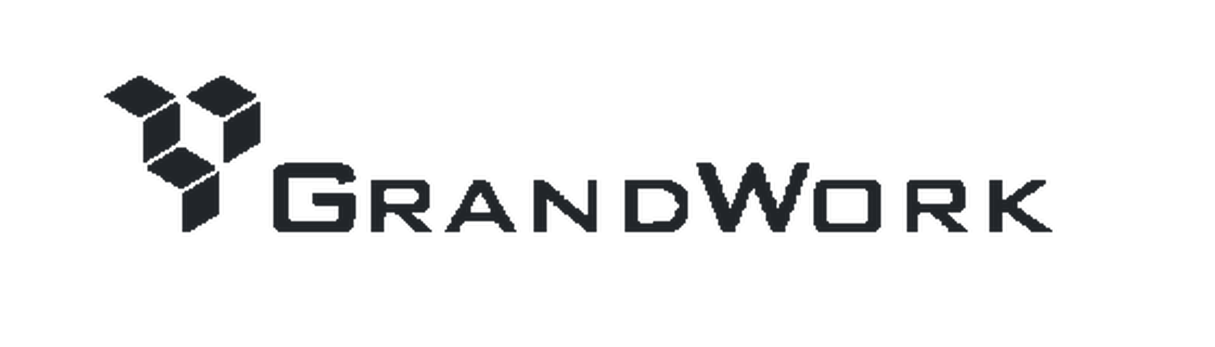
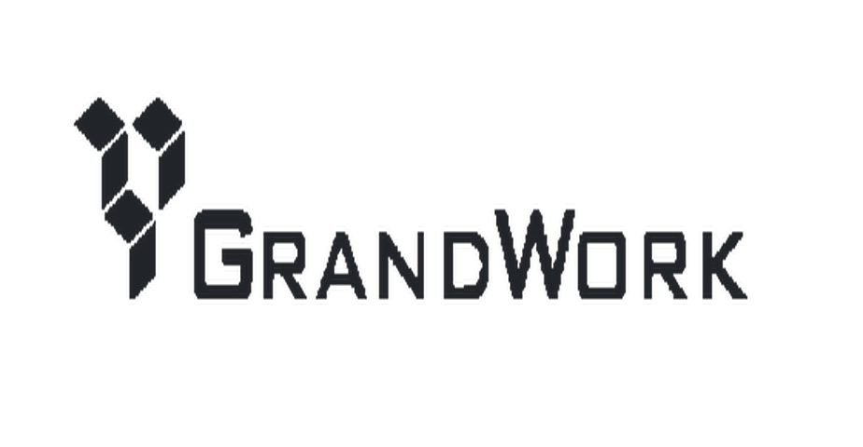
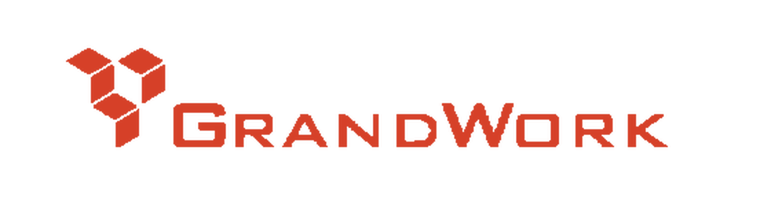
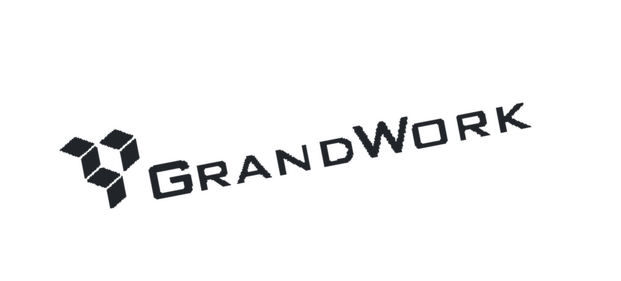
Brand Guide
TOP TIER INTERIOR FIT-OUT WORKS
PRIMARY LOGO
REVERSED LOGO
COLOUR SYSTEM
GRANDWORK INK
STEEL GREY
CHARCOAL
RULE
PAPER
On paper or a light ground. The default lockup — never re-space, re-weight or re-colour it.
Reversed on ink or over photography. No other colourway is permitted.
HEX #212529
RGB 33 37 41
K 84%
HEX #6D6E71
RGB 109 110 113
K 56%
HEX #585858
RGB 88 88 88
K 65%
HEX #D6D6D6
RGB 214 214 214
K 16%
HEX #FFFFFF
RGB 255 255 255
K 0%
CLEAR SPACE + MINIMUM SIZE
ARTWORK STATUS
Steel Grey #6D6E71 is the only owned colour on the site; everything else resolves to Bootstrap defaults. The blue that appears in links is framework default, not brand.
Clear space on all sides equals the cap-height of the wordmark. Minimum width 28 mm in print, 80 px on screen.
Mark reproduced from the live site asset. Replace with the original vector before print — the web file is raster only.
TYPOGRAPHY
LOGO ON BACKGROUNDS
Primary face
Support face
Mont
Inter
Mont is the primary face. Inter, Eurostile and Oswald are also live on the site — four families for one brand. Consolidate to Mont plus one support face.
On ink — reversed
On white — primary
On accent — permitted
DESIGN ELEMENTS
MISUSE — NEVER
stretch · re-colour · rotate · outline
+
01
—
Multiple-award-winning custom interior fittings for the world's most demanding brands.
Grid module
Project index
Hairline
No distortion
No other colour
No rotation
— grandwork.com.sg
Values above were read from the live site. K% is derived from RGB; no Pantone is published by this brand.
RETAIL · F&B · COMMERCIAL · HOSPITALITY · RESIDENTIAL · HEALTHCARE
Grandwork Brand Guide

