Slide 1

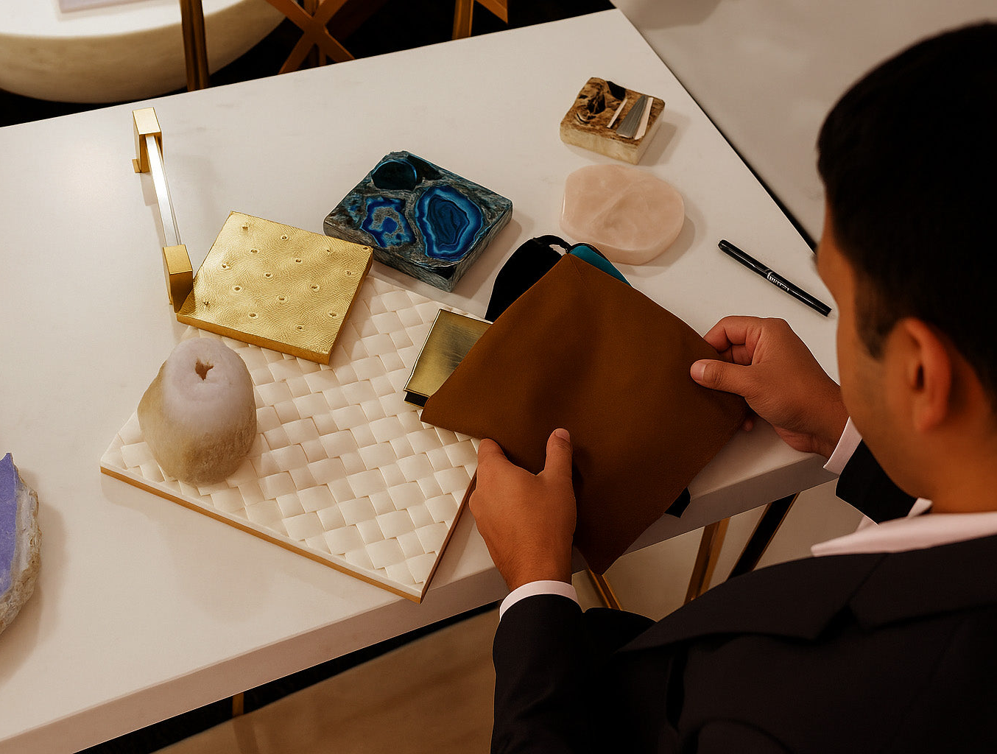
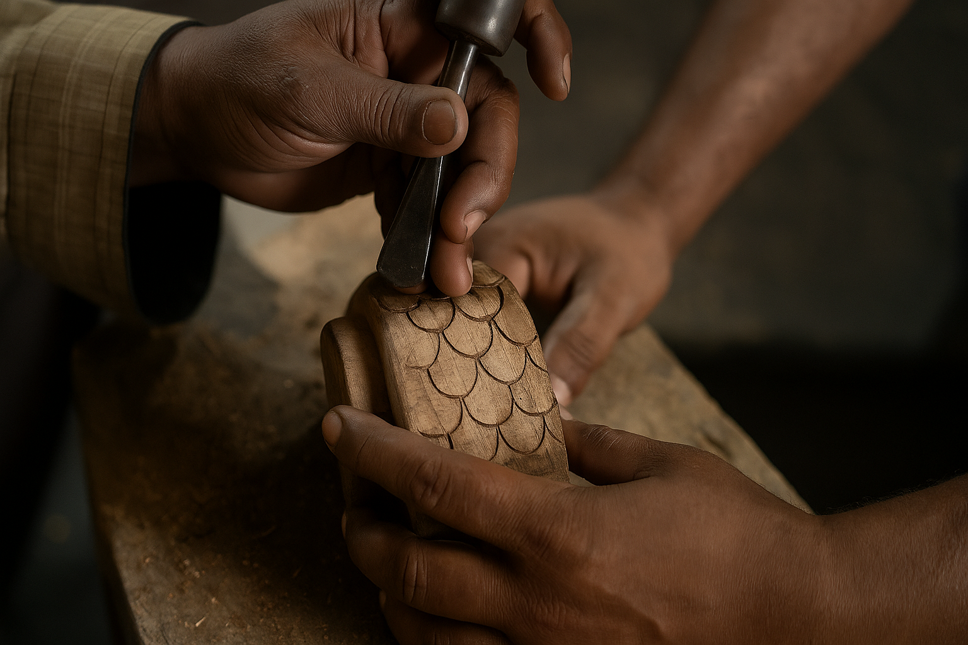
Brand Strategy
WHERE SHARED VISION MEETS ENDURING CRAFT.
IPSEIPSAIPSUM.COM
STRATEGY CORE
MESSAGING + BEHAVIOUR
01
AUDIENCE
01
MESSAGE
Design-conscious homeowners, hospitality and commercial teams, plus architects and interior designers seeking distinctive, responsibly made pieces.
Bespoke begins with collaboration—not a catalogue.
02
MESSAGE
02
POSITIONING
Heritage techniques and contemporary design create objects no mass process can repeat.
A Singapore design studio and furniture brand that turns individual vision into enduring custom forms through materials, prototyping and artisan craft.
03
MESSAGE
COLLABORATION → DEVELOPMENT → EXECUTION
Materials are chosen for beauty, origin, impact and longevity.
BRAND EXPRESSION
03
BRAND PROMISE
Your design vision, thoughtfully realised—distinctive pieces with character, context and staying power.
04
VISUAL DIRECTION
Your design vision,
thoughtfully realised.
Editorial restraint around richly detailed objects; olive and celadon anchors; tactile close-ups; pattern used as evidence, not ornament.
04
PERSONALITY
THE PROOF SYSTEM
Curious, cultured and expressive. Humanly imperfect, collaborative and quietly unconventional.
05
GUARDRAILS
01
DESIGN STUDIO
Never imitate generic luxury, hide the maker, overclaim sustainability, or let decoration overpower function and material truth.
From shared brief to concept, prototype and production.
05
VOICE
Warm, intelligent and specific. Tell the story of material and maker; invite co-creation without mystifying the process.
02
MATERIAL LIBRARY
Rare, reclaimed and responsibly chosen possibilities.
03
ARTISAN CRAFT
Hands, histories and human variation made visible.
LIVE THE ORDINARY, EXTRAORDINARILY · DESIGNED TOGETHER · MADE WITH LASTING CHARACTER
01 / 02
Notes:
[Sources]
- https://ipseipsaipsum.com/ (brand language, process, audience and positioning cues; official imagery)
- https://ipseipsaipsum.com/pages/design-studio (design-studio offer, prototyping, material sourcing, fabrication and project sectors)
- https://ipseipsaipsum.com/pages/craftsmanship-techniques (artisan craft and human variation)
- https://ipseipsaipsum.com/pages/materials-origins (material library and provenance)
- https://ipseipsaipsum.com/pages/social-impact (longevity, material and maker impact themes)
- https://ipseipsaipsum.com/cdn/shop/files/Creative_Collaboration_1_sepia_toned.jpg?v=1758188716 (official photograph)
- https://ipseipsaipsum.com/cdn/shop/files/Fabrication_Execution_2.png?v=1757588557 (official photograph)
[/Sources]

Slide 2
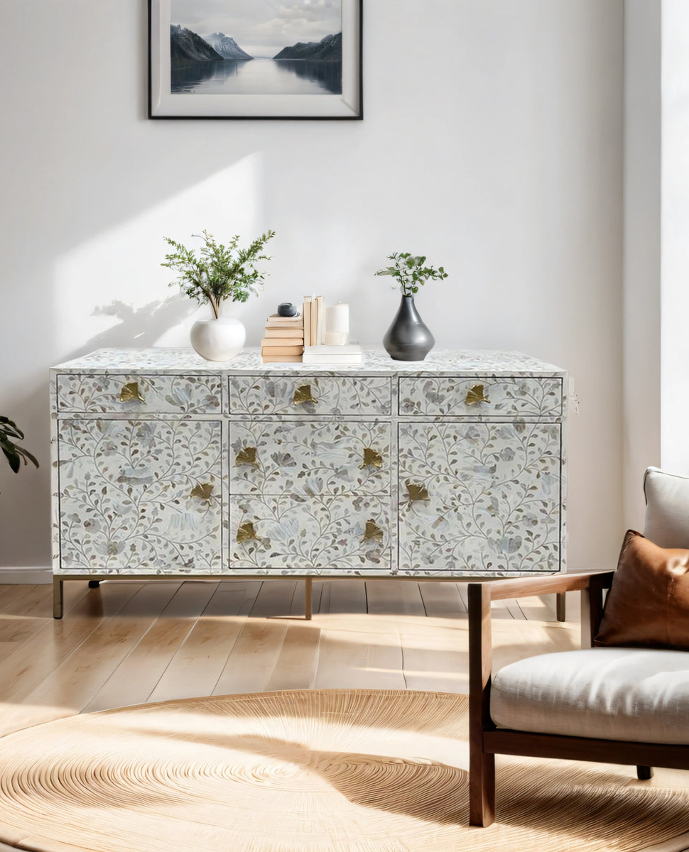
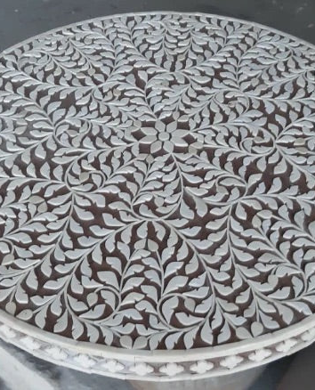
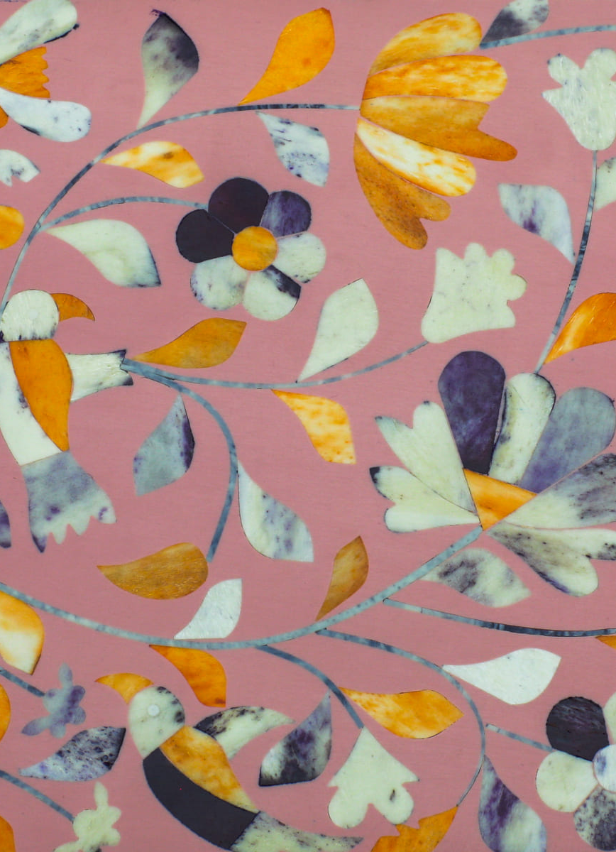
Brand Guide
LIVE THE ORDINARY, EXTRAORDINARILY.
IPSEIPSAIPSUM.COM
LOGO SYSTEM
COLOUR SYSTEM
RECOMMENDED CONTROLS
CLEAR SPACE
One word-line height on every side.
MINIMUM SIZE
100 px screen / 28 mm print.
CONTRAST
Black on White or Celadon. Use a supplied reverse mark only.
WHITE
PAPER
CELADON
OLIVE
CACAO
#FFFFFF
#FAF7F7
#DDE7C2
#728158
#302B23
Olive carries recognition. Celadon creates generous fields. Paper and White keep richly detailed objects breathable; Cacao anchors hierarchy.
TYPOGRAPHY
PHOTOGRAPHY
Montserrat
REGULAR 400
Body copy and generous statements
MEDIUM 500
Navigation and functional labels
SEMIBOLD 600
Headlines and essential emphasis
Aa Bb Cc 0123456789
VERBAL + DESIGN SYSTEM
VOICE PRINCIPLE
Warm, not ornate
Specific, not mystical
Cultured, not elitist
Expressive, not excessive
Make craft
tangible.
Start with the idea. Reveal the hand. End with how it lives.
Use pattern as a cropped material detail—never as visual noise.
OBJECT IN CONTEXT · MATERIAL MACRO · MAKER OR PROCESS
MISUSE — NEVER
Stretch or crop the mark · invent logo colours · default to generic luxury stock · overdecorate
Working system derived from the live public brand · 02 September 2026
MATERIAL-LED GRIDS · HUMAN DETAIL · OLIVE RECOGNITION · GENEROUS NEGATIVE SPACE
02 / 02
Notes:
[Sources]
- https://ipseipsaipsum.com/ (official logo, brand language, palette and type cues)
- https://ipseipsaipsum.com/pages/design-studio (creative process, material and maker cues)
- https://ipseipsaipsum.com/pages/craftsmanship-techniques (photography and craft-direction cues)
- https://ipseipsaipsum.com/pages/materials-origins (material and pattern direction)
- https://ipseipsaipsum.com/cdn/shop/files/ipse_Vertical_Stack_black.png?v=1757046183 (official logo)
- https://ipseipsaipsum.com/cdn/shop/files/PenangMOPSideboardLifestyle.jpg?v=1716699084 (official photograph)
- https://ipseipsaipsum.com/cdn/shop/files/inlay-work-image_7701750c-7cd1-40ec-8dff-d2c20081f302.jpg?v=1760948057 (official photograph)
- https://ipseipsaipsum.com/cdn/shop/files/Fabrication_Execution_2.png?v=1757588557 (official photograph)
- https://ipseipsaipsum.com/cdn/shop/files/Peranakan_pink_blue_and_orange_bone_inlay.jpg?v=1781770590 (official material image)
[/Sources]

