Slide 1

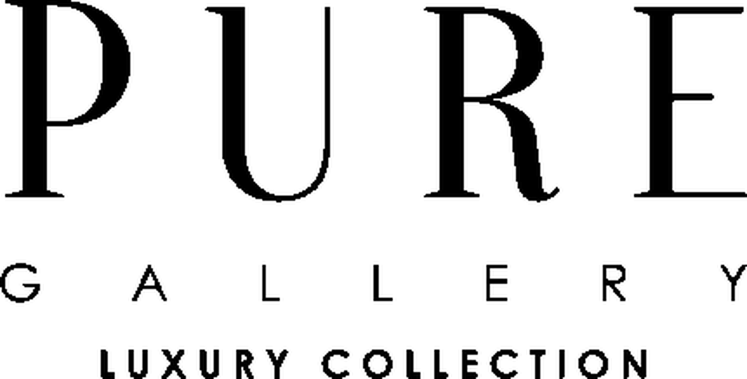

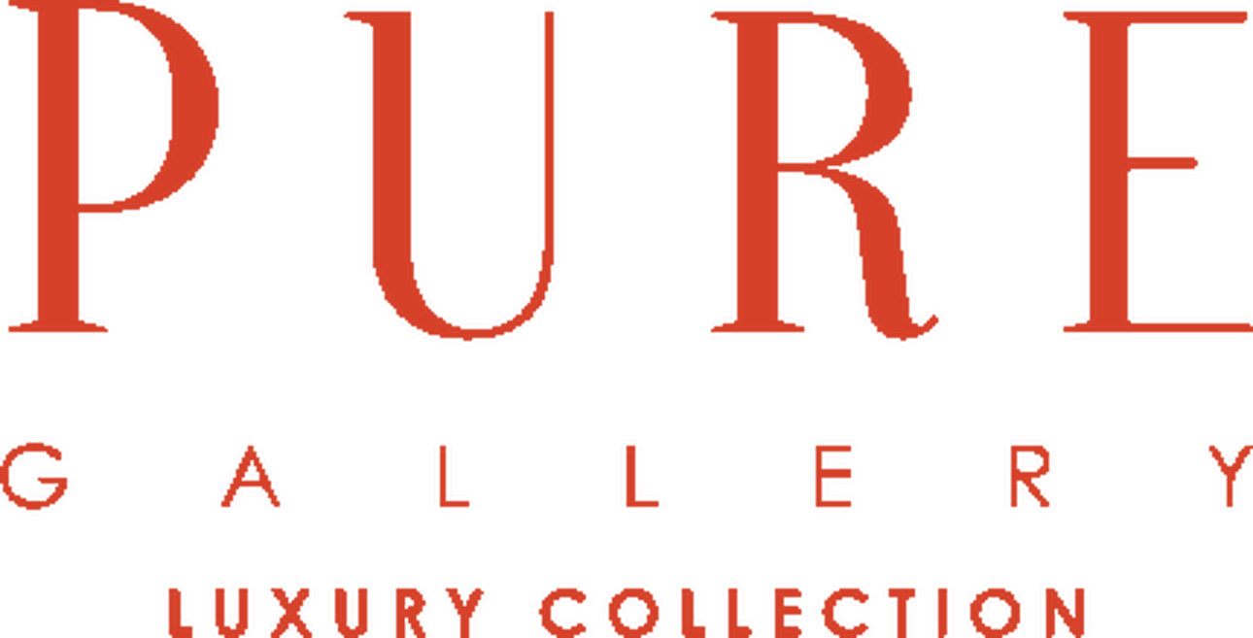

Brand Guide
EMBRACE CULTURE WITH STYLE
PRIMARY LOGO
REVERSED LOGO
COLOUR SYSTEM
PURE BLACK
MIDNIGHT
PLUM
PAPER
On paper or a light ground. The default lockup — never re-space, re-weight or re-colour it.
Reversed on ink or over photography. No other colourway is permitted.
HEX #000000
RGB 0 0 0
K 100%
HEX #081721
RGB 8 23 33
K 87%
HEX #371049
RGB 55 16 73
K 71%
HEX #FFFFFF
RGB 255 255 255
K 0%
CLEAR SPACE + MINIMUM SIZE
ARTWORK STATUS
The system is near-monochrome. Midnight and Plum appear only as deep accents behind imagery; neither is used as a text colour. No accent is published for interface use.
Clear space on all sides equals the cap-height of the wordmark. Minimum width 28 mm in print, 80 px on screen.
Mark reproduced from the live site asset. Replace with the original vector before print — the web file is raster only.
TYPOGRAPHY
LOGO ON BACKGROUNDS
Primary face
Century Gothic
The logotype is set in a high-contrast Didone serif — it is artwork, not a system font, and must never be re-set. Century Gothic carries the website; Zapfino appears once, for the tagline only.
On ink — reversed
On white — primary
On accent — permitted
DESIGN ELEMENTS
MISUSE — NEVER
stretch · re-colour · rotate · outline
Aa
II
—
Embrace Culture With Style.
Script accent
Two-door split
Hairline
No distortion
No other colour
No rotation
— pureinterior.com.sg
Values above were read from the live site. K% is derived from RGB; no Pantone is published by this brand.
PURE GALLERY · LUXURY PURE STUDIO · PERSONALISED
PURE Brand Guide

